Slide 1
Integrating Gender-Based Violence Response into Family Planning and Reproductive Health Service Delivery
—Day 1—

Slide 2
Module 0
Introduction to Training
INTEGRATING GBV-RESPONSE INTO FP AND RH SERVICE DELIVERY
SLIDE 2

Slide 3
MODULE 0 | SESSION A
Introductions, Group Norms, and Pre-Test
INTEGRATING GBV-RESPONSE INTO FP AND RH SERVICE DELIVERY
MODULE 0 | SESSION A | SLIDE 3

Slide 4
Overall Goal of Training
Advance knowledge and skill set of family planning (FP) and sexual and reproductive health (SRH) service providers to address gender-based violence (GBV) and provide GBV-responsive care within FP/RH service interactions.
INTEGRATING GBV-RESPONSE INTO FP AND RH SERVICE DELIVERY
MODULE 0 | SESSION A | SLIDE 4

Slide 5
Learning Outcomes
Gain greater understanding and knowledge of gender norms, dynamics, equity, and their role in GBV.
Gain a greater understanding of how GBV manifests in FP and SRH service provision and uptake.
Increase knowledge of how GBV is relevant to FP services, including GBV risk identification and analysis.
Gain skills to mitigate and respond to GBV threats within the context of FP and sexual and reproductive health and rights (SRHR) activities.
Master skills required to deliver the first three steps of the LIVES pneumonic for disclosure response.
Gain knowledge on how to refer GBV survivors to appropriate service providers/facilities in a safe and ethical way.
Develop skill sets to manage GBV case recording and reporting during FP and SRH service provision.
INTEGRATING GBV-RESPONSE INTO FP AND RH SERVICE DELIVERY
MODULE 0 | SESSION A | SLIDE 5

Slide 6
Module 1
Understanding Gender and GBV
INTEGRATING GBV-RESPONSE INTO FP AND RH SERVICE DELIVERY
MODULE 1 | SLIDE 6

Slide 7
MODULE 1 | SESSION A
Understanding Gender in FP Services
What You Can Expect to Learn
Gain clear concepts of gender, gender equity and equality, and their impact on power and violence.
INTEGRATING GBV-RESPONSE INTO FP AND RH SERVICE DELIVERY
MODULE 1 | SESSION A | SLIDE 7

Slide 8
What Does Gender Mean to You?
Turn to a person near you and share reflections
based on these three questions:
Share a time when you became aware of your gender.
Describe a time when you felt happy about your gender.
Has there been a time when you felt scared, discriminated against, or sad because of your gender?
INTEGRATING GBV-RESPONSE INTO FP AND RH SERVICE DELIVERY
MODULE 1 | SESSION A | SLIDE 8

Slide 9
Definition of Gender
Gender is about the roles, norms, and behaviors that society consider appropriate for women, men, girls, boys, and those with diverse gender identities, such as transgender. These are socially constructed and vary widely within and across cultures, religions, class, and ethnicity. For example, in many societies a common gender norm is that women and girls should do most of the domestic work.
Source: Pathfinder International
INTEGRATING GBV-RESPONSE INTO FP AND RH SERVICE DELIVERY
MODULE 1 | SESSION A | SLIDE 9

Slide 10
It’s not fair or equal…
WOMEN ARE HALF THE WORLD’S POPULATION.
YET, WOMEN LIVE WITH A 3X GREATER LIFETIME EXPERIENCE OF GENDER-BASED VIOLENCE. IN LOW AND MIDDLE INCOME COUNTRIES, GENDER DISCRIMINATION RESULTS IN AN ESTIMATED 3.9 MILLION EXCESS DEATHS AMONG WOMEN AND GIRLS BY THE AGE OF 60.
Source: World Bank
INTEGRATING GBV-RESPONSE INTO FP AND RH SERVICE DELIVERY
MODULE 1 | SESSION A | SLIDE 10

Slide 11
Let’s Try a Gender Quiz
Please read each statement below carefully. Then check the appropriate box to answer the question: Does this issue relate to sex or does it relate to gender?
INTEGRATING GBV-RESPONSE INTO FP AND RH SERVICE DELIVERY
MODULE 1 | SESSION A | SLIDE 11

Slide 12
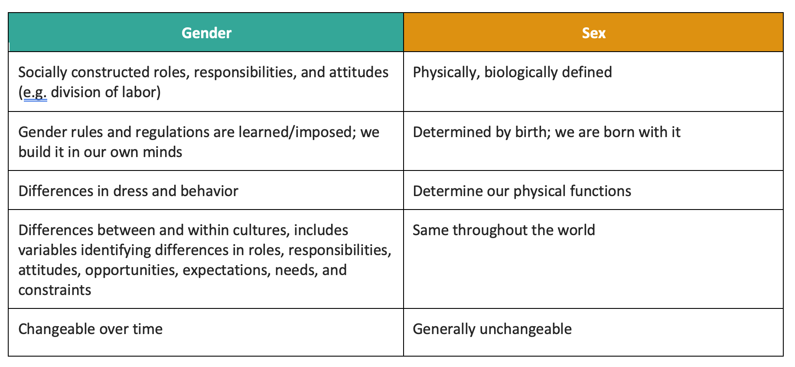
Understanding the Difference Between Sex and Gender
INTEGRATING GBV-RESPONSE INTO FP AND RH SERVICE DELIVERY
MODULE 1 | SESSION A | SLIDE 12

Slide 13
Key Terms
Gender Norms
What society considers male and female behavior, leading to the formation of gender roles, which are the roles men and women, and boys and girls, are expected to take in society.
Gender Awareness
An awareness of the differences in roles and relations between women and men. It recognizes that the life experiences, expectations, and needs of women and men are different, varying across the culture and society.
Gender Equity
The absence of discrimination based on a person’s sex or gender. Gender equity means providing the same opportunity to each person, including access to and control of social, economic, and political resources, including protection under the law, such as health services, education, and voting rights.
INTEGRATING GBV-RESPONSE INTO FP AND RH SERVICE DELIVERY
MODULE 1 | SESSION A | SLIDE 13

Slide 14
Key Terms continued
Gender Discrimination
Any distinction, exclusion, or restriction made on the basis of socially constructed gender roles and norms, which prevents a person from enjoying full human rights.
Gender-Related Barriers
Obstacles to access and use of health services, which are related to deep-rooted social and cultural norms about the roles of women, men, and those with diverse gender identities.
Gender-Based Violence (GBV)
Any act that is perpetrated against a person’s will and is based on gender norms and unequal power relationships. This includes threats or acts of coercion, arbitrary deprivation of liberty, neglect, or discrimination, whether occurring in public or in private life. GBV encompasses physical or sexual assault, emotional or psychological harm, denial of resources or access to services, and denial of legal self-autonomy.
INTEGRATING GBV-RESPONSE INTO FP AND RH SERVICE DELIVERY
MODULE 1 | SESSION A | SLIDE 14

Slide 15
Understanding Gender and Power
Power is the capacity or ability to direct or influence the behavior of self, others, or the course of events.
Power Over: an individual or institution’s degree of power translates to their capacity to exploit others, regardless of intention or action to do so.
Power To: an individual or institution’s capacity to create without using relationships of domination. The capacity to act and to exercise agency and realize the potential of goals, rights, or aspirations.
Power Within: a person’s sense of their own capacity and self-worth. It is related to the productive sense of ‘power to’ and a prerequisite to holding or increasing one’s ‘power to.’
Power With: collective power within, to, or over that comes from intentional solidarity amongst individuals or groups. This collective power can be mobilized both within and across class, caste, religious, gender and age differences.
INTEGRATING GBV-RESPONSE INTO FP AND RH SERVICE DELIVERY
MODULE 1 | SESSION A | SLIDE 15

Slide 16
Power and GBV
Any action, threat, or exercise of control that uses gender roles and norms to decrease a person’s power is gender-based violence.
Intersectional factors increase or decrease a person’s vulnerability
The greater the power an individual or institution holds, the easier it is for them to perpetrate gender-based violence.
INTEGRATING GBV-RESPONSE INTO FP AND RH SERVICE DELIVERY
MODULE 1 | SESSION A | SLIDE 16

Slide 17
Case Study 1: Rahima
What elements of Rahima’s story demonstrate the common gender norms and expectations in your communities?
Do you see examples of the men and women in Rahima’s story having different levels or different types of power?
Do you think that gender norms and gender-specific power influences the FP choices in Rahima’s story? Why or why not?
Do you see examples of GBV in Rahima’s story? Why or why not?
INTEGRATING GBV-RESPONSE INTO FP AND RH SERVICE DELIVERY
MODULE 1 | SESSION A | SLIDE 17

Slide 18
MODULE 1 | SESSION B
Gender Relevance in FP Success and Failure
What You Can Expect to Learn
Gain insights into gender role in FP success and failure, including how failure can be transformed into a success story.
Be able to articulate the relevance of gender discrimination and GBV to optimize FP and SRH services.
INTEGRATING GBV-RESPONSE INTO FP AND RH SERVICE DELIVERY
MODULE 1 | SESSION B | SLIDE 18

Slide 19
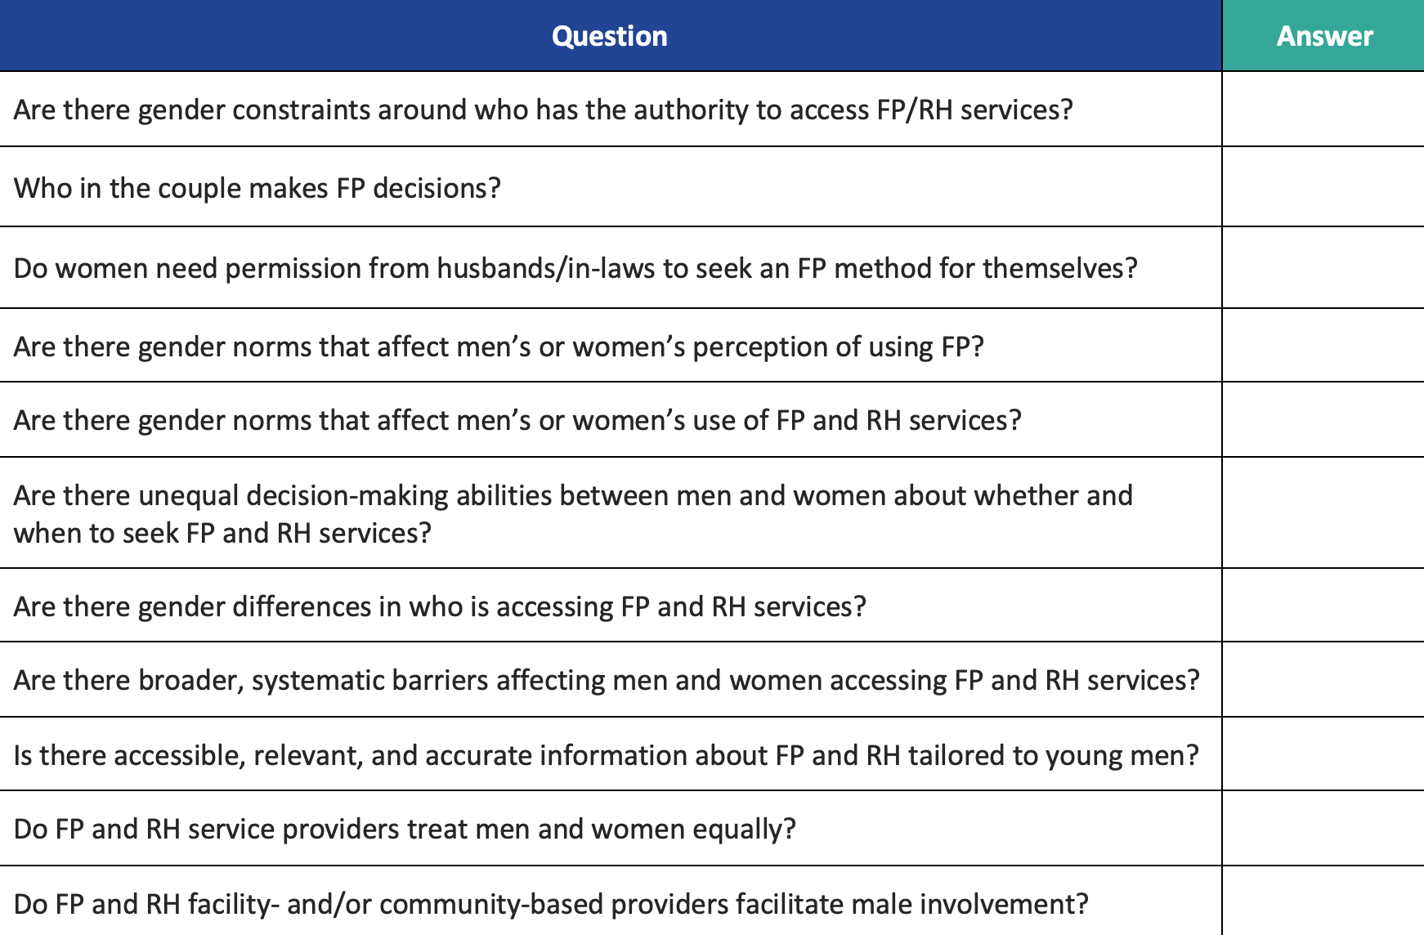
Questions to Assess How Gender Affects FP and RH Outcomes
INTEGRATING GBV-RESPONSE INTO FP AND RH SERVICE DELIVERY
MODULE 1 | SESSION B | SLIDE 19

Slide 20
The Power of FP for Women and Development
“Investing in family planning is a development ‘best buy’ that can accelerate achievement across the 5 Sustainable Development Goal themes of People, Planet, Prosperity, Peace, and Partnership.”
Family planning has been identified as the highest impact investment per dollar spent to achieve the Sustainable Development Goals.
Source: Ellen Starbird, Maureen Norton, and Rachel Marcus. “Investing in Family Planning: Key to Achieving the Sustainable Development Goals,” Global Health: Science and Practice, 2016 Jun 20; 4(2): 191–210.
INTEGRATING GBV-RESPONSE INTO FP AND RH SERVICE DELIVERY
MODULE 1 | SESSION B | SLIDE 20

Slide 21
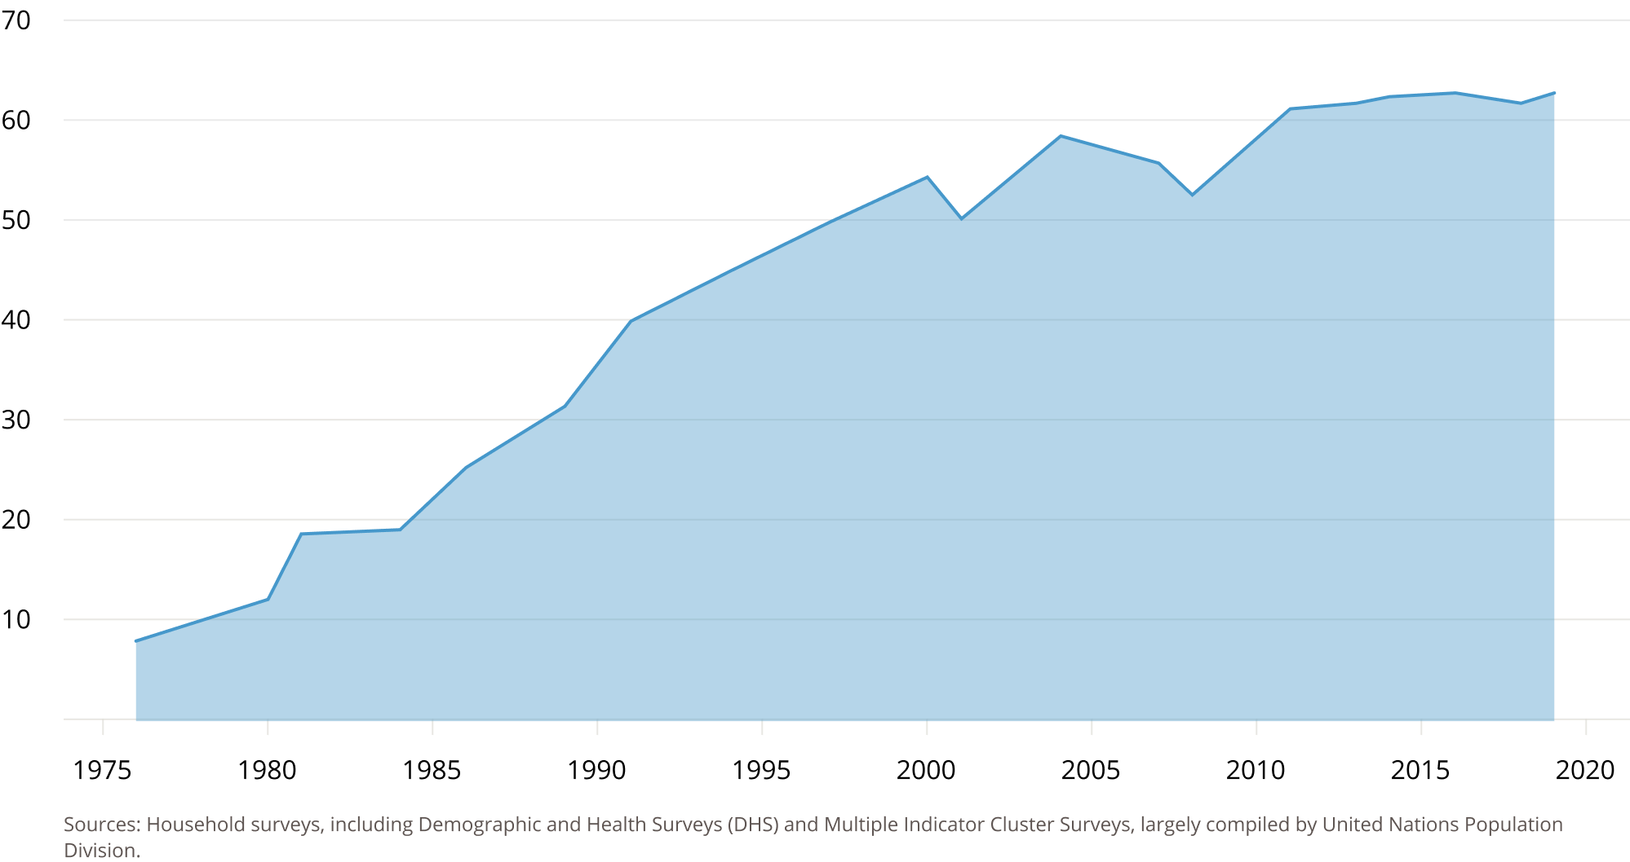
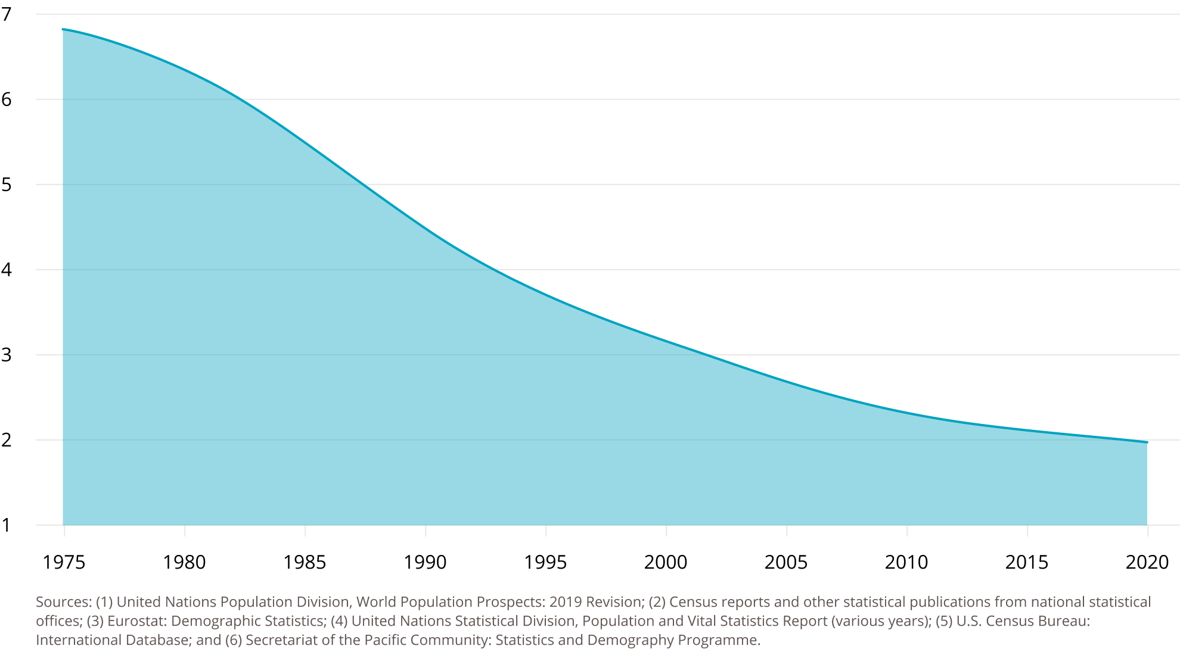
Bangladesh has achieved historic progress in expanding access to voluntary contraception for nearly half a century.
Increase in Contraceptive Use
Decrease in Total Fertility Rate
INTEGRATING GBV-RESPONSE INTO FP AND RH SERVICE DELIVERY
MODULE 1 | SESSION B | SLIDE 21

Slide 22
Bangladesh’s Historic FP Progress
One of the oldest family planning programs in the world (launched 1953).
In less than 50 years, percentage of married women of reproductive age who are using family planning increased sevenfold.
Today, contraceptive prevalence rate is 62 percent, and 52 percent of women are using modern contraceptive methods.*
GOB and DGFP has strong commitment and farsighted vision for FP program.
Source: BDHS 2017–2018
INTEGRATING GBV-RESPONSE INTO FP AND RH SERVICE DELIVERY
MODULE 1 | SESSION B | SLIDE 22

Slide 23
Opportunities for Progress
Address high rates of discontinuation: 37% of contraceptive users stop their selected method within 12 months.
Improve service quality and method mix: only 9% of currently married women are using a long-acting or permanent method.
Address unmet need among adolescents: 16% of adolescents ages 15–19 have an unmet need for FP, compared to 5% among women at the end of their childbearing years (45–49)
Improve services offered to women who were or are child brides: Nearly one-third (31%) of women ages 20–49 report that they had married by age 15.
Source: BDHS 2017–2018
INTEGRATING GBV-RESPONSE INTO FP AND RH SERVICE DELIVERY
MODULE 1 | SESSION B | SLIDE 23

Slide 24
Case Studies 2–5: Hena, Nazma, Rani, and Mr. Hossain
How does gender influence the power of the people in the story?
Where do see gender and power helping achieve good FP and SRH?
Where do you see gender and power being a barrier to good health?
INTEGRATING GBV-RESPONSE INTO FP AND RH SERVICE DELIVERY
MODULE 1 | SESSION B | SLIDE 24

Slide 25
Other Relevant Barriers
Stock outs
Lack of funding
Lack of skilled service providers
Distance to health service point
Misinformation in communities
Opportunity costs
Service provider bias
Legislative and legal barriers
Cultural norms and traditions
INTEGRATING GBV-RESPONSE INTO FP AND RH SERVICE DELIVERY
MODULE 1 | SESSION B | SLIDE 25

Slide 26
Module 2
Foundations in GBV
INTEGRATING GBV-RESPONSE INTO FP AND RH SERVICE DELIVERY
MODULE 2 | SLIDE 26

Slide 27
MODULE 2 | SESSION A
Understanding and Conceptualizing GBV
What You Can Expect to Learn
Be able to articulate the many different forms and manifestation of GBV.
Understand how GBV is an intersectional issue that can affect anyone regardless of age, marital status, or economic class.
Be able to communicate the health risks and impacts suffered by those living with GBV.
INTEGRATING GBV-RESPONSE INTO FP AND RH SERVICE DELIVERY
MODULE 2 | SESSION A | SLIDE 27

Slide 28
Unpacking GBV
Gender-Based Violence (GBV)
Any act perpetrated against a person’s will and is based on gender norms and unequal power relationships. It encompasses:
Threats of violence and coercion
Physical or sexual assault
Emotional or psychological harm
Denial of resources or access to services
Denial of legal self-autonomy
It inflicts harm on women, girls, men and boys.
Violence Against Women & Girls (VAWG)
Any act based on gender norms or unequal power dynamics that results in, or is likely to result in, physical, sexual, or mental harm to women, including threats, coercion, or arbitrary deprivation of liberty—whether occurring in public or in private life. It includes:
Intimate partner violence
Sexual assault and rape
Female genital cutting
Reproductive coercion
Forced marriage
Trafficking
Denial of education, financial, and legal services
INTEGRATING GBV-RESPONSE INTO FP AND RH SERVICE DELIVERY
MODULE 2 | SESSION A | SLIDE 28

Slide 29
Forms and Manifestations of GBV
PHYSICAL
Hitting, beating, burning, cutting
Trafficking
Acid attacks, honor killings
EMOTIONAL/PSYCHOLOGICAL
Abuse, Humiliation
Confinement/Isolation
Intimidation/Threats
Blame for uncontrollable outcomes
SOCIAL
Discrimination, and/or denial of opportunities
Denial of education
Denial of inheritance and/or property rights
SEXUAL
Forced Marriage
Sexual Exploitation/Forced Prostitution
Rape*
Harassment
Female Genital Cutting
INTEGRATING GBV-RESPONSE INTO FP AND RH SERVICE DELIVERY
MODULE 2 | SESSION A | SLIDE 29

Slide 30
Reproductive Coercion
A complex form of VAWG that can be perpetrated using physical, sexual, psychological and/or social violence—most commonly perpetrated through a combination of these forms.
Examples:
Repeated shaming and blaming of a woman until she gives birth to a son
Forcing a women or girl to undergo menstrual regulation to avoid pregnancy
Throwing away contraceptive pills or condoms
Using a pin to put holes in condoms
Denying a women freedom of movement and/or access to resources to access family planning
INTEGRATING GBV-RESPONSE INTO FP AND RH SERVICE DELIVERY
MODULE 2 | SESSION A | SLIDE 30
Notes:
Reproductive coercion can be very explicit and direct such as contraceptive sabotage or directly refusing to allow a woman to go to a FP appointment, refusing to take her for MR, forcing a woman to have unprotected sex when she is fertile, etc. It can also be more indirect using forms of social and psychological/physical violence such as patterns of humiliation and abuse against women who do not demonstrate fertility early and frequently.

Slide 31
National GBV Prevalence
VAW in Bangladesh Facts 2017 study | A total 1,143 victims
63.78% belonged to the age group of 16–30 years, 19.16% belonged to the age group of 1– 15 years.
71.91% were married, and 25.63% were unmarried.
60.37% were housewives, followed by others (11.46%), students (11.11%) and maid servants (10.85%).
Most of the perpetrators were husbands (64.65%), followed by the known person (14.00%), neighbors 26 (13.30%), lovers (3.15%), house master and mistress (2.62%), in-laws and others (2.27%).
Report on VAW Survey 2015
72.6 % of ever-married women experienced violence by their husband at least once in their lifetime.
27.8% of women reported lifetime physical violence by someone other than their husband.
The lifetime rates of emotional and sexual violence are 28.7% and 27.2%, respectively.
INTEGRATING GBV-RESPONSE INTO FP AND RH SERVICE DELIVERY
MODULE 2 | SESSION A | SLIDE 31

Slide 32
UN Special Declaration
Article 1: For the purposes of this Declaration, the term "violence against women" means any act of gender-based violence that results in, or is likely to result in, physical, sexual or psychological harm or suffering to women, including threats of such acts, coercion or arbitrary deprivation of liberty, whether occurring in public or in private life.
Article 4: States should condemn violence against women and should not invoke any custom, tradition or religious consideration to avoid their obligations with respect to its elimination. States should pursue by all appropriate means and without delay a policy of eliminating violence
INTEGRATING GBV-RESPONSE INTO FP AND RH SERVICE DELIVERY
MODULE 2 | SESSION A | SLIDE 32

Slide 33
National Laws and Commitments
In 2014, Bangladesh committed to ending child marriage in the country by 2041.
Multiple facets of the penal code provide for severe punishment in cases of specific forms of GBV, including acid attacks, femicide to gain new or increased dowry, and denial of child custody.
Signatory to international conventions include ICPD and the UN Special Declaration against Violence against Women.
Marital rape is exempt from legal prosecution excepting cases where the wife is below age 13.
INTEGRATING GBV-RESPONSE INTO FP AND RH SERVICE DELIVERY
MODULE 2 | SESSION A | SLIDE 33
Notes:
It is important to note that the legal framework regarding marital rape in Bangladesh is complex and contradictory. All laws confirm that intimate relations between spouses when the wife is under the age of 13 is rape.
It is also clear that martial rape is not criminalized in Bangladesh when the wife is of legal age to be married (18). However, for married adolescents aged 13-18 it is unclear what level of legal protection they may have. As health providers, what you need to know is:
- all women, regardless of age or marital status are entitled to access emergency contraception services.
- all girls under the age of 18 are legally entitled to refuse marriage

Slide 34
MODULE 2 | SESSION B
GBV Risk Analysis in FP and SRHR
What You Can Expect to Learn
Recognize and communicate GBV impacts across the life cycle.
Identify verbal and non-verbal cues that an FP and SRH client is high risk for current GBV.
INTEGRATING GBV-RESPONSE INTO FP AND RH SERVICE DELIVERY
MODULE 1 | SESSION B | SLIDE 34

Slide 35
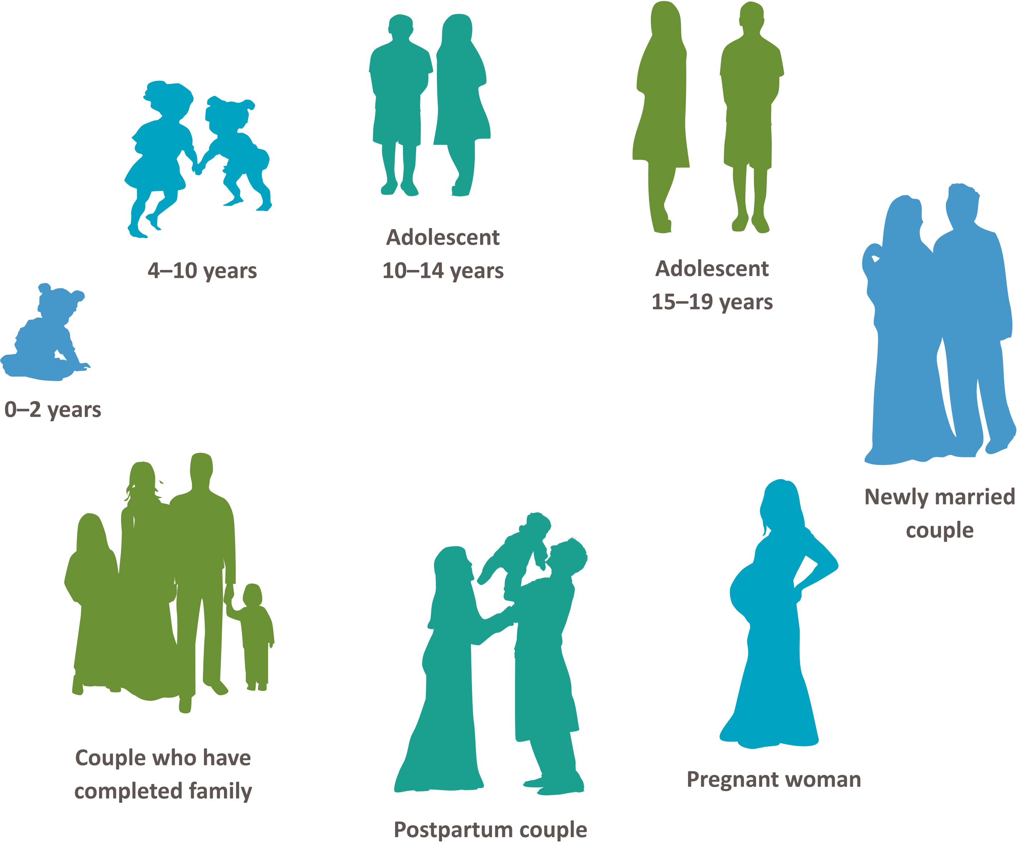
LIFE CYCLE APPROACH
INTEGRATING GBV-RESPONSE INTO FP AND RH SERVICE DELIVERY
MODULE 2 | SESSION B | SLIDE 35

Slide 36
GBV IN FP AND SRH ACROSS THE LIFE CYCLE
Denial of access to education
Sexual violence
Restriction on movement to reach services
Reproductive coercion
CEFMU
Son preference
Contraceptive sabotage
Other repro coercion
Restriction of movement
Coercion to prove fertility
Intimate partner violence
Denial of resources to access care
Reproductive coercion
Obstetric violence
Intimate partner violence
Denial of resources to access care
Forced repeat pregnancy
Forced menstrual regulation
INTEGRATING GBV-RESPONSE INTO FP AND RH SERVICE DELIVERY
MODULE 2 | SESSION B | SLIDE 36

Slide 37
GBV Impacts Across the Life Cycle
Mental health impacts: e.g., depression, anxiety, flashbacks, substance abuse, suicide ideation
Sexual and reproductive health impacts: e.g., unintended pregnancy, HIV, STIs, cervical cancer, miscarriage, pre-term labor, stillbirth
Physical impacts: e.g., broken bones, contusions, internal bleeding, malnourishment, death
Social impacts: e.g., school dropout, unemployment, isolation, limited contribution to civil society, poverty
INTEGRATING GBV-RESPONSE INTO FP AND RH SERVICE DELIVERY
MODULE 2 | SESSION B | SLIDE 37

Slide 38
Women living with intimate partner violence are:
TWICE as likely
to experience depression
16% more likely
to have a low-birth-weight baby
1.5x more likely to acquire chlamydia, gonorrhea, and HIV
38% of all murders of women were committed by their intimate partners
Source: WHO, Caring for women subjected to violence: a WHO curriculum for training health-care providers, revised edition (Geneva: 2021).
INTEGRATING GBV-RESPONSE INTO FP AND RH SERVICE DELIVERY
MODULE 2 | SESSION B | SLIDE 38

Slide 39
What Can GBV Look Like in FP and SRH?
A woman in the postpartum ward who waits until her mother-in-law has gone outside to ask about PPFP
A FP client who frequently has bruises on her face or wrists when she comes for refill appointments
An adolescent girl who doesn’t speak for herself when brought by a parent for MR
A FP client who asks if there are options that her husband cannot throw away
An IUD client who returns with her partner soon after insertion asking for removal
Living with GBV is different for everyone! Never force a disclosure. Never assume someone is immune to GBV.
INTEGRATING GBV-RESPONSE INTO FP AND RH SERVICE DELIVERY
MODULE 2 | SESSION B | SLIDE 39

Slide 40
MODULE 2 | SESSION C
Male Engagement in GBV Prevention Awareness
What You Can Expect to Learn
Clarify concepts around male engagement in GBV prevention awareness, including pros and cons, challenges and successes, and evidence.
INTEGRATING GBV-RESPONSE INTO FP AND RH SERVICE DELIVERY
MODULE 1 | SESSION B | SLIDE 40

Slide 41
Male Engagement in GBV Prevention
“Engaging men and boys as users, supportive partners, and agents of change improves health outcomes. More specifically, engaging men in FP/RH programs has been successful in decreasing unintended pregnancies, improving maternal health, reducing sexually transmitted infections (STIs) and HIV/AIDS, and better meeting the needs of youth.”
Source: Breakthrough ACTION
INTEGRATING GBV-RESPONSE INTO FP AND RH SERVICE DELIVERY
MODULE 2 | SESSION C | SLIDE 41

Slide 42
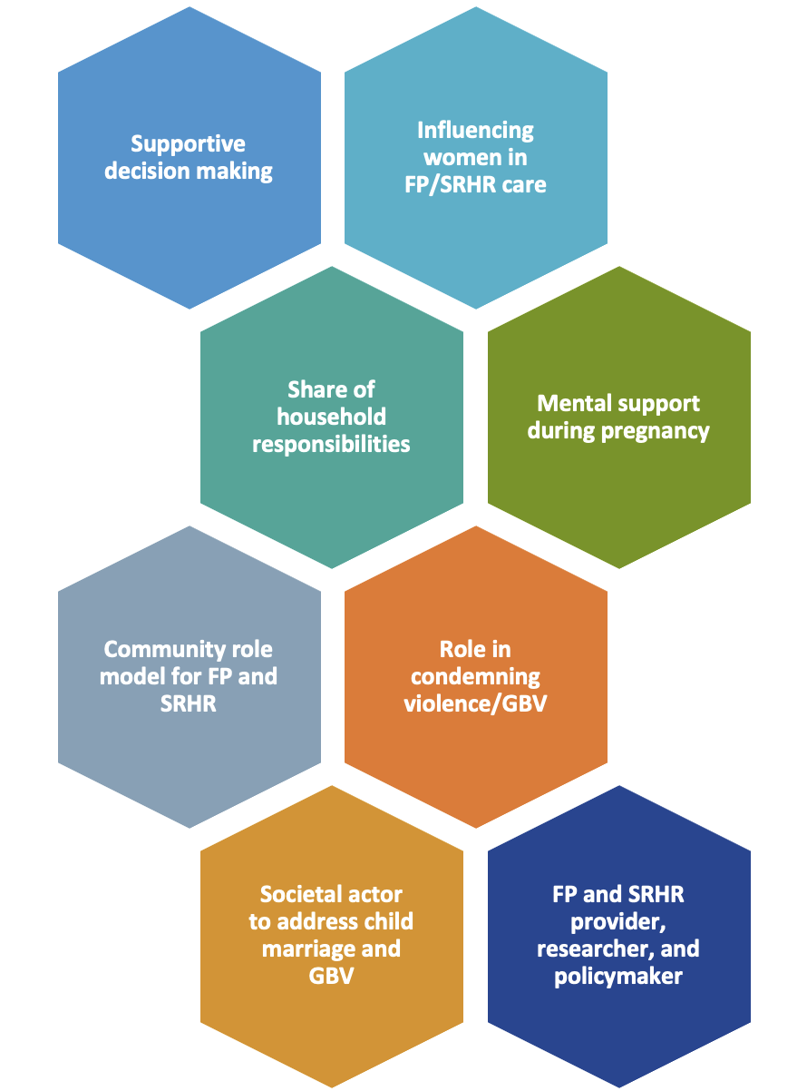
Potential Role of Male Engagement to Improve Women’s FP and SRHR Status
INTEGRATING GBV-RESPONSE INTO FP AND RH SERVICE DELIVERY
MODULE 2 | SESSION C | SLIDE 42

Slide 43
Benefits of Male Engagement in SRHR
Male engagement can reduce the spread of STIs, HIV and AIDS.
Male engagement can lessen the ill effects of men’s risky sexual behavior on the health of women and children.
Men and husband, in most cases, approve of FP.
Men make decisions that affect women's and men’s health.
Men can gain awareness that gender affects sexual behavior, reproductive decision-making, and reproductive health.
Male engagement can help meet demands from women for more involvement.
It provides opportunities for men to promote better RH, and they can play a role.
As individuals, men benefit from intentional family building and chosen timing and spacing of children.
As family members, men honor their responsibilities to care for their wives and children by only having children and when safe and healthy for the family.
As community leaders and policymakers, men support strong, thriving communities by encouraging intentional FP and health timing and spacing of pregnancies.
INTEGRATING GBV-RESPONSE INTO FP AND RH SERVICE DELIVERY
MODULE 2 | SESSION C | SLIDE 43

Slide 44
Risks of Male Engagement in SRHR
Already imbalanced power over fertility and health decisions
More attention to men in limited resource setting (human resource, logistics, and client time) can result in unintentional pulling of resources away from women- and girl-centered outreach and services.
INTEGRATING GBV-RESPONSE INTO FP AND RH SERVICE DELIVERY
MODULE 2 | SESSION C | SLIDE 44

Slide 45
Key Things to Learn about Involving Men in FP
Engaging men in FP is a personal issue.
Check your assumptions.
Understand power dynamics.
Own the reality: for better or for worse, men are involved.
Men are underserved, yet many want to be engaged fathers and supportive partners.
Men are FP clients and users in their own right.
Don’t count men out of health services.
Providers need to think about social norms too.
Address men even when they are not present.
Reach men where they are, through their networks.
Men can and do participate positively in FP.
When done right, involving men in FP can yields significant benefits for women and families.
INTEGRATING GBV-RESPONSE INTO FP AND RH SERVICE DELIVERY
MODULE 2 | SESSION C | SLIDE 45

Slide 46
In Safe Motherhood and SRHR,
Men play many key roles, their decisions and actions make a difference during
Pregnancy
Delivery
Postpartum period
INTEGRATING GBV-RESPONSE INTO FP AND RH SERVICE DELIVERY
MODULE 2 | SESSION C | SLIDE 46

Slide 47
Men: Full Partners and Advocates for Good Reproductive Health
Reaching men is a winning strategy. Yes / No
To encourage sexual responsibility. Yes / No
To foster men’s support of their partners’ contraceptive choices. Yes / No
To address the reproductive health care of couples. Yes / No
Men play dominant roles in decisions. Yes / No
Men are more interested in family planning than assumed. Yes / No
Need communication and services directed specifically to them. Yes / No
Understanding-and influencing-the balance of power is important. Yes / No
Couples who talk to each other reach better, healthier decisions. Yes / No
INTEGRATING GBV-RESPONSE INTO FP AND RH SERVICE DELIVERY
MODULE 2 | SESSION C | SLIDE 47

Slide 48
MODULE 2 | SESSION D
Understanding GBV in FP and SRH for Adolescents and Youth
What You Can Expect to Learn
Be able to articulate the risks and impacts of child, early, and forced marriage and unions (CEFMU) and GBV among young people.
Understand how national laws impact FP and RH service provision for CEMFU-involved clients.
INTEGRATING GBV-RESPONSE INTO FP AND RH SERVICE DELIVERY
MODULE 1 | SESSION B | SLIDE 48

Slide 49
Adolescent and Youth SRHR and CEFMU
Basic Concepts
Terms and Definitions
Child, Early, and Forced Marriage and Unions (CEFMU)
Adolescents: 10–19 years
Youth: 15–24 years
Young People: 10–24 years
Child and early marriage is any marriage in which one of the parties involved is below the age of 18. Forced marriage and unions refer to any union in which one party did not consent—regardless of their age. This term includes both formal, legal marriages, and as well informal union and cohabitation.
INTEGRATING GBV-RESPONSE INTO FP AND RH SERVICE DELIVERY
MODULE 2 | SESSION D | SLIDE 49

Slide 50
Comprehensive SRHR Services for Young People
Provision of a full range of contraceptive information and supplies, including emergency contraceptives
Counseling and information services on FP, pregnancy, and the prevention and treatment of STIs and RTIs
Basic equipment for provision of reproductive health services (e.g.: FP, antenatal care, laboratory testing for STIs/RTIs)
Services that cater to interrelated issues, such as mental health, nutrition, sexual abuse, and GBV
Capacity to accommodate the needs of young people with special needs
Referral system
INTEGRATING GBV-RESPONSE INTO FP AND RH SERVICE DELIVERY
MODULE 2 | SESSION D | SLIDE 50

Slide 51
Concept of Child Marriage
According to BDHS 2017–18, 71% of women ages 20–49 were married by age 18, and nearly one-third (31%) of women 20–49 reported that they had married by age 15.
Bangladesh’s Child Marriage Restraint Act, 2017 (CMRA) repealed the earlier British law of 1929. The Act sets the minimum age of marriage for a male as 21 years and for a female as 18 years. This refers to both formal marriages and informal unions in which children under the age referred with a partner as if married.
To address the child marriage situation of the country, the Honorable Prime Minister of Bangladesh made the following commitments in July 2014:
Create a National Plan of Action by the end of 2014 (prepared in 2018);
Revise the Child Marriage Restraint Act 1929 (revised in 2017);
End the marriage of under 15-year-olds and reduce by one third child marriage under 18 years by 2021
Eradicate child marriage from the country by 2041.
INTEGRATING GBV-RESPONSE INTO FP AND RH SERVICE DELIVERY
MODULE 2 | SESSION D | SLIDE 51

Slide 52
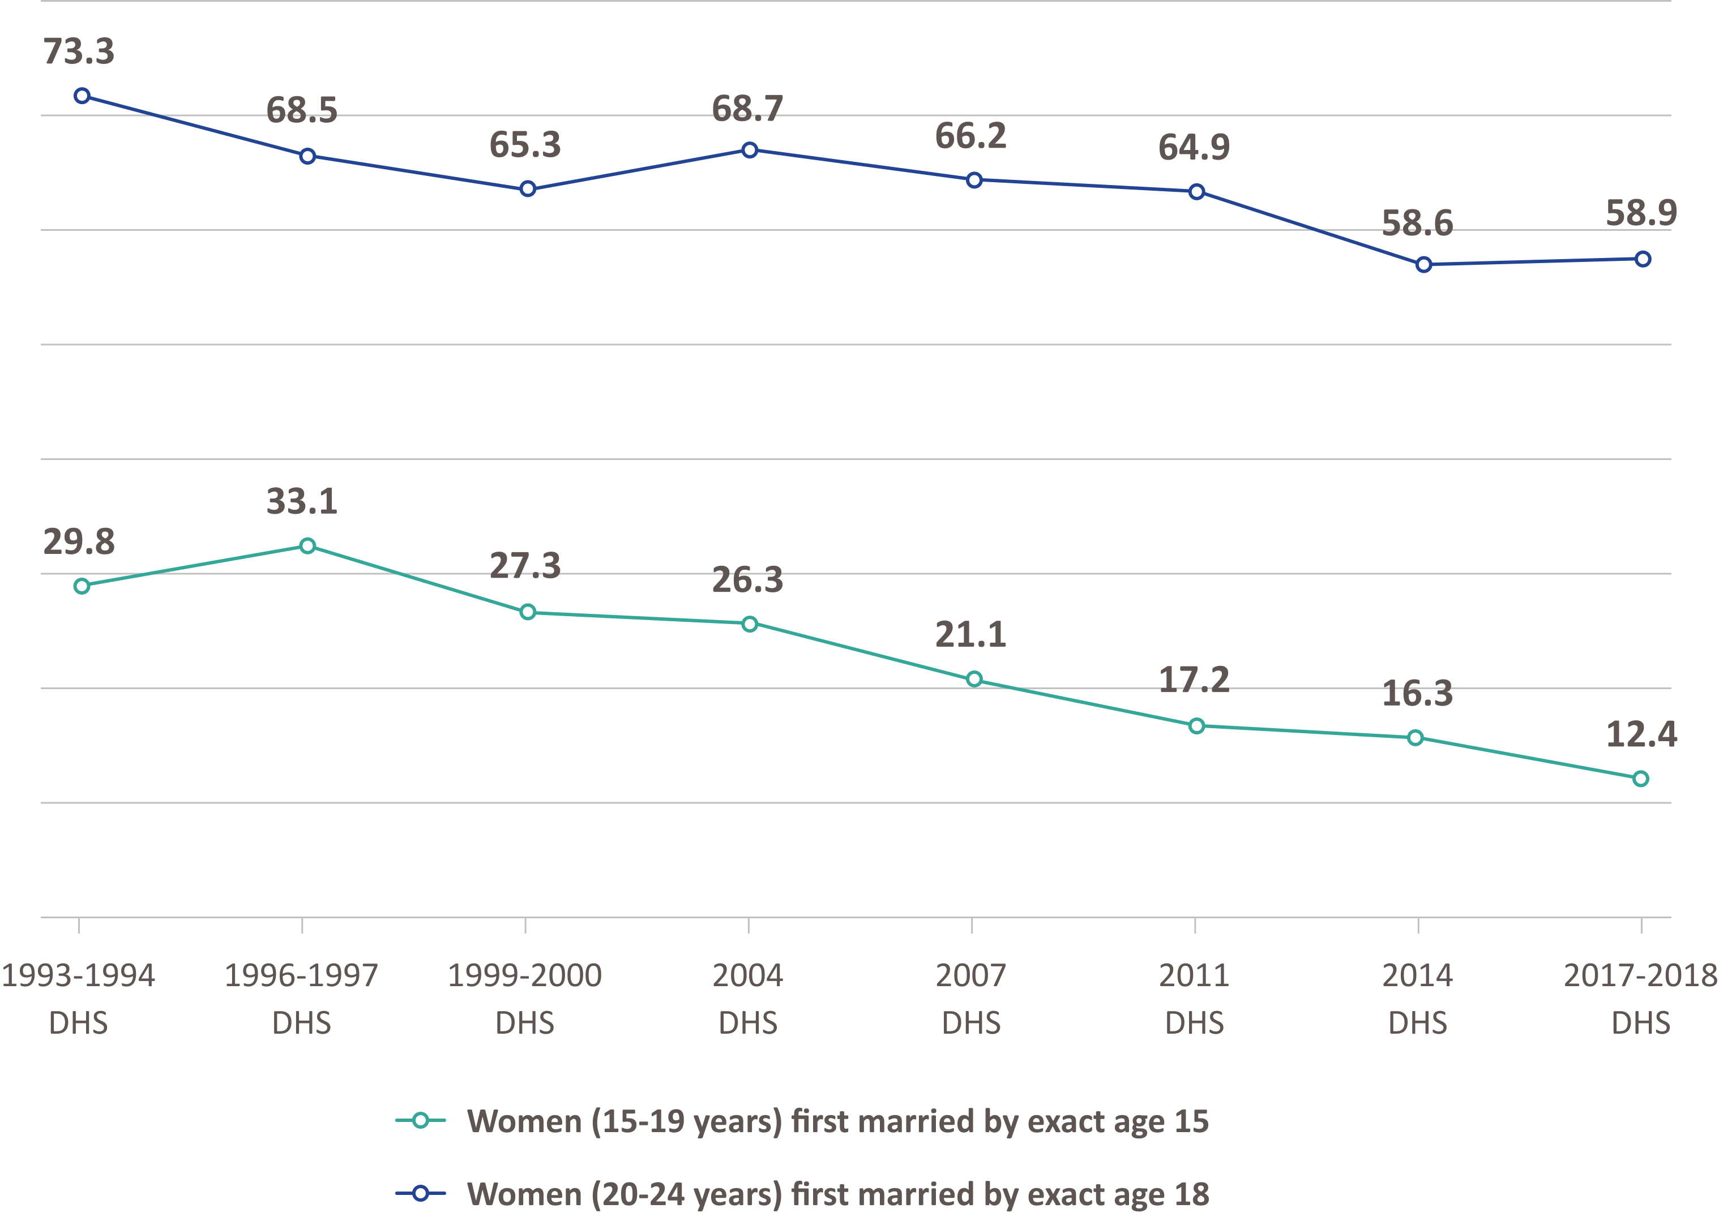
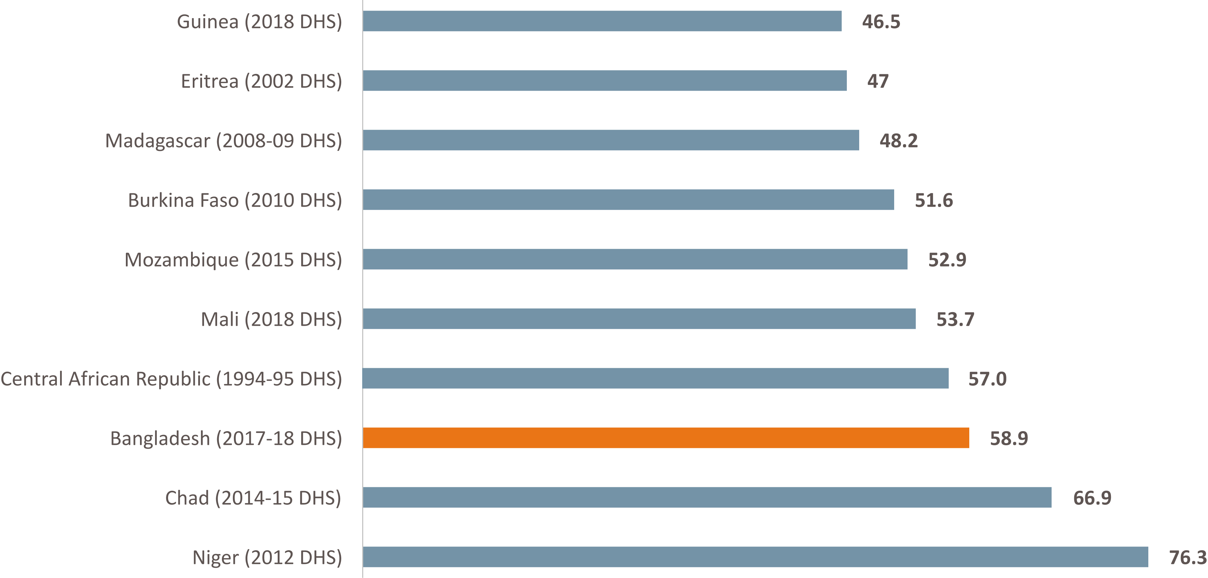
Trends (%) of Child Marriage in Bangladesh, 1993–2017
% of Women (20–24 years) First Married by Exact Age 18: Top Ten Countries
INTEGRATING GBV-RESPONSE INTO FP AND RH SERVICE DELIVERY
MODULE 2 | SESSION D | SLIDE 52

Slide 53
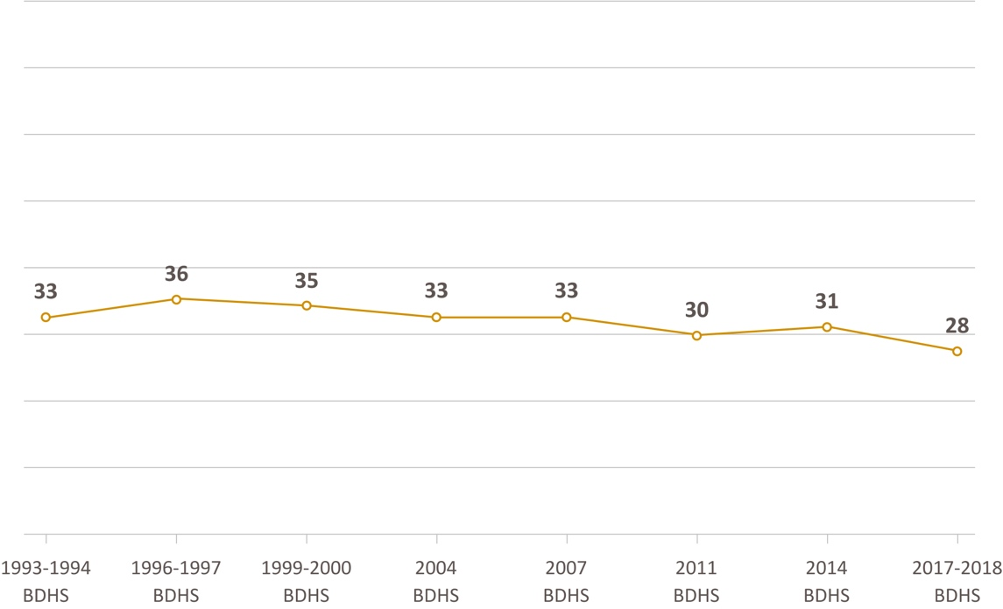
Teenage Childbearing in Bangladesh
Drivers of Adolescent Childbearing
Social stigma and poverty.
After giving birth, the status of girls’ and boys’ (wife and husband) may improve.
Lack of girls’ individual identity/ empowerment/agency.
Barriers to contraceptive access and use among adolescent girls (unmet needs).
Misconceptions around contraception.
Familial and social pressure, and insecurity.
Presumptions of infidelity and/or extra marital relationship.
INTEGRATING GBV-RESPONSE INTO FP AND RH SERVICE DELIVERY
MODULE 2 | SESSION D | SLIDE 53

Slide 54
Let’s make a list of the SRHR service needs of adolescents and youth
Type of service needs | Most common | Sometimes | Rare Need | GBV as Driver — Y/N
Malnutrition
General health problems (e.g.: viral infection, bacterial illness, asthma, UTI)
Menstrual problems
Mental health issues (e.g.: depression, anorexia, sexual identity questions)
Contraception
Emergency contraception & menstrual regulation
Sexually transmitted infection
Addictive behaviors
Physical trauma (e.g: broken bones, contusions, lacerations)
Sexual abuse and assault response
INTEGRATING GBV-RESPONSE INTO FP AND RH SERVICE DELIVERY
MODULE 2 | SESSION D | SLIDE 54

Slide 55
Case Studies 6–8: Meena, Parvin, and Khadija
To Present in Plenary
Key facts of the vignette
How was the case was first noticed in the FP/SRH clinic?
What are your gender- and GBV-relevant observations?
What are the solution points you considered—to handle the case?
INTEGRATING GBV-RESPONSE INTO FP AND RH SERVICE DELIVERY
MODULE 2 | SESSION D | SLIDE 55

Slide 56
Values Clarification
Vote with Your Feet
There is no right answer
Be prepared to share why you have placed yourself where you have
Power dynamics, values, and beliefs are complicated
INTEGRATING GBV-RESPONSE INTO FP AND RH SERVICE DELIVERY
MODULE 2 | SESSION D | SLIDE 56

Slide 57
Key Takeaways
Gender is socially constructed and gives everyone habits, values, biases, and assumptions.
GBV affects 2 in 3 women in Bangladesh and has significant impacts on FP and SRH outcomes.
People from all walks of life and of all ages experience GBV.
Reproductive coercion is GBV.
Addressing GBV is something men and women can and should tackle together.
INTEGRATING GBV-RESPONSE INTO FP AND RH SERVICE DELIVERY
MODULE 2 | SESSION D | SLIDE 57

Slide 58
Questions?
INTEGRATING GBV-RESPONSE INTO FP AND RH SERVICE DELIVERY
MODULE 2 | SESSION D | SLIDE 58

Slide 59
Thank you!

