Slide 1
Integrating Gender-Based Violence Response into Family Planning and Reproductive Health Service Delivery
—Day 2—

Slide 2
Welcome Back
TODAY’S OBJECTIVES
Develop foundation skills in GBV-responsive FP and SRH service provision, disclosure response, and referrals to comprehensive GBV services.
Develop knowledge and foundation skills on GBV case recording, reporting, and referral confirmation.
INTEGRATING GBV-RESPONSE INTO FP AND RH SERVICE DELIVERY
SLIDE 2

Slide 3
Module 3
GBV-Responsive FP and SRH Service Provision
INTEGRATING GBV-RESPONSE INTO FP AND RH SERVICE DELIVERY
SLIDE 3

Slide 4
MODULE 3 | SESSION A
GBV-Responsive Counseling in FP and SRH
What You Can Expect to Learn
The difference between universal counseling versus selective screening for GBV.
The pros and cons of different FP methods for clients living with intimate partner violence (IPV) and/or reproductive coercion.
How to demonstrate active listening during client-centered counseling.
INTEGRATING GBV-RESPONSE INTO FP AND RH SERVICE DELIVERY
MODULE 3 | SESSION A | SLIDE 4

Slide 5
Concept of Counseling
A two-way interaction between a client and a provider.
An interpersonal, dynamic communication process that involves a kind of contractual agreement between a client and a counselor who is trained to an acceptable standard and who is bound by a code of ethics and practice.
A process of dialogue and mutual interaction between counselor and counselee aimed at facilitating problem-solving, motivation, and decision-making of the counselee
Requires empathy, genuineness, and the absence of any moral or personal judgment.
INTEGRATING GBV-RESPONSE INTO FP AND RH SERVICE DELIVERY
MODULE 3 | SESSION A | SLIDE 5

Slide 6
Principles of Client-Centered Counseling
Privacy; ensure audio and visual privacy.
Take sufficient time.
Maintain confidentiality.
Ask the client about their priorities. Listen to their answer.
Keep it simple; use common language. Avoid overly scientific/technical words.
First things first: do not cause confusion by giving too much information.
Say it again; repeat the most important information at the beginning, in the middle, and the end.
Use available visual aids, like posters and flip charts, etc.
Seek feedback from the client.
INTEGRATING GBV-RESPONSE INTO FP AND RH SERVICE DELIVERY
MODULE 3 | SESSION A | SLIDE 6

Slide 7
Counseling with Active Listening
IT IS IMPORTANT TO:
Use eye contact, as long as this is culturally acceptable in your particular setting. It shows interest.
Use open-ended questions. They allow clients to express themselves.
Check your understanding by summarizing (paraphrasing).
Nod and use acknowledgment sounds that convey your interest and keep the conversation flowing, but avoid unnecessarily interrupting your client.
Use a tone of voice that shows interest.
Listen for feelings as well as facts.
Limit active note taking and verbally communicate to the client why you are writing things down as they speak.
INTEGRATING GBV-RESPONSE INTO FP AND RH SERVICE DELIVERY
MODULE 3 | SESSION A | SLIDE 7

Slide 8
Counseling with Active Listening
DO NOT:
Interrupt the client unnecessarily.
Finish the client’s sentences.
Let your mind wander and spend listening time formulating your responses or thinking about your dinner!
INTEGRATING GBV-RESPONSE INTO FP AND RH SERVICE DELIVERY
MODULE 3 | SESSION A | SLIDE 8

Slide 9
GATHER Approach in FP Counseling
Greet the client respectfully.
Ask them about their FP needs. Ask if they have any other concerns about their health or safety.
Tell them about different contraceptive options and methods, including information on the FP method’s vulnerability to sabotage and degree of partner involvement needed for proper use.
Help them to make decisions about choices of FP methods.
Explain and demonstrate how to use the FP methods.
Return, referring, and scheduling an appropriately timed return visit. Ask the client for their preferred method of follow up communication and seek consent to send texts or make phone calls. Offer information on GBV services and referral availability.
G Greet
A Ask
T Tell
H Help
E Explain
R Return
INTEGRATING GBV-RESPONSE INTO FP AND RH SERVICE DELIVERY
MODULE 3 | SESSION A | SLIDE 9

Slide 10
IPV/ Reproductive Coercion Considerations in FP Counseling
Method | Pros | Cons | Discussion Points
Injectable Contraceptive | • Does not leave any signs on the skin • No supplies to store | • With two- and three-month types, monthly bleeding often stops after time • Another injection is needed every one, two, or three months, depending on type | • Are you concerned that your partner may track your periods? • Do you think you could go for re-injection visits without fail?
Implant | • Works well for several years • Usually, no follow-up required • No supplies to store | • Sometimes can be felt and seen under the skin of arm • May cause spotting or changes in menstrual bleeding (often improves after three months) | • Are you concerned that your partner may track your periods?
Copper or LNG IUD | • Remains out of sight in the uterus • Copper IUD works well for at least 12 years; LNG-IUD, for 3–5 years • Usually, no follow-up required • No supplies to store | • Copper IUD often increases menstrual flow • Hormonal IUD can make period lighter or stop • Caution if women has current STI or high STI risk • Partner may feel ends of strings in cervix | • Are you concerned that your partner may track your periods? • Do you think you may have an STI or are likely to get an STI?
Pill | • Does not leave any signs on skin • Little effect on menstrual bleeding | • Must be taken every day • Pills/packaging must be kept in safe place | • Do you have a safe place to keep the pills?
Adapted from WHO’s Caring for Women Subjected to Violence curriculum.
INTEGRATING GBV-RESPONSE INTO FP AND RH SERVICE DELIVERY
MODULE 3 | SESSION A | SLIDE 10

Slide 11
GATHER Skills Practice: Role Plays 1–3
Observers should provide feedback on:
Did the provider follower the steps and use active listening?
Did the provider follow client cues to guide discussion and selection of methods?
Did the provider give information that was GBV-responsive?
Clients should give feedback on:
Did you feel listened to? Why or why not?
What did the provider do that was helpful?
What could the provider have done to make you feel more comfortable?
INTEGRATING GBV-RESPONSE INTO FP AND RH SERVICE DELIVERY
MODULE 3 | SESSION A | SLIDE 11

Slide 12
MODULE 3 | SESSION B
Responding to Disclosures of GBV
What You Can Expect to Learn
Explain the purpose and value of psychological first aid
Understanding the role of quality disclosure response in FP settings
Deliver the first three steps of the LIVES approach to first-line response
INTEGRATING GBV-RESPONSE INTO FP AND RH SERVICE DELIVERY
MODULE 3 | SESSION B | SLIDE 12

Slide 13
Responding to Disclosures
As FP providers, you may be the first and/or only person this woman has been able to tell about what she is dealing with. Your response matters.
Remember:
It is never the survivor’s fault.
Everyone deserves to feel and be safe.
Services and support are available in your district.
INTEGRATING GBV-RESPONSE INTO FP AND RH SERVICE DELIVERY
MODULE 3 | SESSION B | SLIDE 13

Slide 14
LIV(ES) Listen, Inquire, Validate, Enhance safety, and Support
The LIV(ES) pneumonic was developed by the World Health Organization to ensure first line response to violence against women in primary and preventative health care settings.
Listen – Listen closely with empathy, no judgment.
Inquire – Assess and respond to the client’s needs and concerns – emotional, physical, social, and practical.
Validate – Show the client you believe and understand them.
Enhance Safety – Discuss how to protect the client from further harm.
Support – Help connect the client to appropriate resources and services, including social support.
Psychological First Aid
INTEGRATING GBV-RESPONSE INTO FP AND RH SERVICE DELIVERY
MODULE 3 | SESSION B | SLIDE 14

Slide 15
LIV(ES) Step | Sample Phrases to Use
L - Listen | I hear you. I’m listening. We have time if you there is anything else you want to tell me.
I - Inquire | What can I do to help? Are you worried about your safety if you tell your partner? How are you feeling? Are you in pain?
V - Validate | That must have been very difficult. I’m so sorry this happened to you You did not/do not deserve this Thank you for telling me. Sadly, this happens to many women. You are not alone.
INTEGRATING GBV-RESPONSE INTO FP AND RH SERVICE DELIVERY
MODULE 3 | SESSION B | SLIDE 15

Slide 16
LIV(ES) Skills Practice: Role Plays 4–6
Reflection Questions:
How did it feel just to listen and not offer “advice” or solutions?
What did the provider do that was helpful?
What could they have done differently?
INTEGRATING GBV-RESPONSE INTO FP AND RH SERVICE DELIVERY
MODULE 3 | SESSION B | SLIDE 16

Slide 17
Risk Identification
The following may be signs that your client is in immediate danger. Should you see these signs or behaviors, you may wish to fetch a GBV specialist colleague and have them join you in the appointment room:
The client tells you she is afraid she will be killed if she returns home.
A client is accompanied by a partner or family member and not allowed to answer questions for themselves.
A child under 13 is seeking MR or emergency contraception.
INTEGRATING GBV-RESPONSE INTO FP AND RH SERVICE DELIVERY
MODULE 3 | SESSION B | SLIDE 17

Slide 18
MODULE 3 | SESSION C
Making GBV Referrals
What You Can Expect to Learn
Know when and how to provide referrals for comprehensive first line response to GBV
INTEGRATING GBV-RESPONSE INTO FP AND RH SERVICE DELIVERY
MODULE 3 | SESSION C | SLIDE 18

Slide 19
Effective Referral Pathway
Case Management Referral System
First Point of Entry
Receives client
Documents service
Refers client to other needed services
Caseworker
Establishes partnership with client
Identifies client needs
Refers client for services and documents referral
Follows up with client
Advocates for client to meet needs cross continuum of care
Health Facility
Diagnoses client
Provides medical treatment
Refers to caseworker
INTEGRATING GBV-RESPONSE INTO FP AND RH SERVICE DELIVERY
MODULE 3 | SESSION C | SLIDE 19

Slide 20
Case Study 9: Lovely
For Group Discussion
What are the steps you will follow to counsel her in a real situation?
In what way you will support the case so she can continue her pregnancy?
What kinds of referrals might you want to make for this case?
INTEGRATING GBV-RESPONSE INTO FP AND RH SERVICE DELIVERY
MODULE 3 | SESSION C | SLIDE 20

Slide 21
One-Stop Crisis Cell
Services of OCC at MCHs
Medical treatment
Social reintegration
Safe custody/shelter home
Rehabilitation
Psychosocial counseling
Social welfare services
Legal support
Police assistance
Forensic DNA test
INTEGRATING GBV-RESPONSE INTO FP AND RH SERVICE DELIVERY
MODULE 3 | SESSION C | SLIDE 21

Slide 22
National Helpline Center as a Referral Way Out
National Helpline Center for VAWC
Victims
Witnesses
Informants
109 Receiver
Place of occurrence
Incidence in brief
Nature of support required
For possible and immediate support
UNO/UWAO/NGO/UPC/OC/Others
Follow up for result
Connect to professionals
Doctor
Nurse
Police
Lawyer
Counselor
DNA expert
Informants
Database system
INTEGRATING GBV-RESPONSE INTO FP AND RH SERVICE DELIVERY
MODULE 3 | SESSION C | SLIDE 22

Slide 23
Important GBV Referral Centre Locations in Bangladesh
One-Stop Crisis Center at MCH
One-Stop Crisis Cell at District
One-Stop Crisis Cell at Upazila
National Trauma Counseling Center (NTCC)
National Forensic DNA Profiling Laboratory
National Helpline Center for Violence Against Women and Children
Regional Trauma Counseling Center (NTCC)
INTEGRATING GBV-RESPONSE INTO FP AND RH SERVICE DELIVERY
MODULE 3 | SESSION C | SLIDE 23

Slide 24
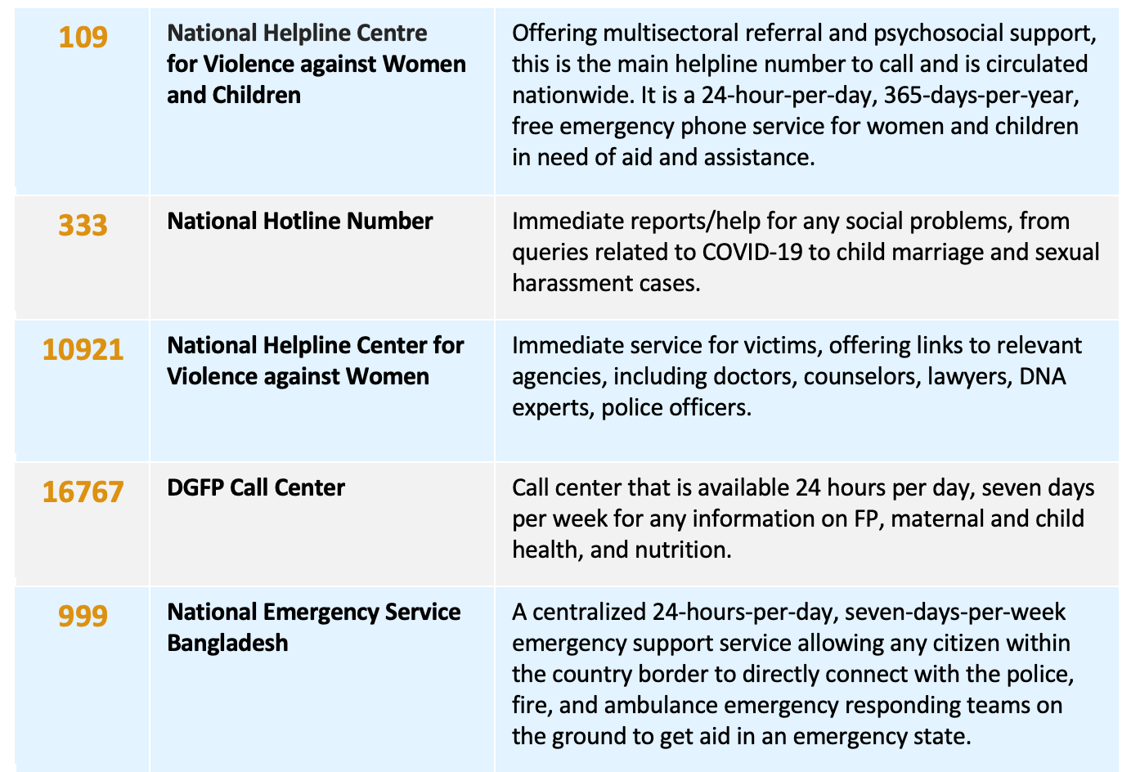
Helplines for the Prevention GBV (VAW) and Child Marriage
INTEGRATING GBV-RESPONSE INTO FP AND RH SERVICE DELIVERY
MODULE 3 | SESSION C | SLIDE 24

Slide 25
Where to Report
There are several places where we can report:
One-Stop Crisis Center
Trauma Counseling Center
Forensic DNA Laboratory
National Help Line for Violence Against Women
Legal Aid Center
Legal Action Center/Police Station
Social Support Center/rehabilitation center
Safe Custody/Shelter Home
Rehabilitation Center
INTEGRATING GBV-RESPONSE INTO FP AND RH SERVICE DELIVERY
MODULE 3 | SESSION C | SLIDE 25

Slide 26
National Trauma Counseling Center (NTCC)
Objective of NTCC
Provide psychosocial counseling support in NTCC, OCC, and safe home to those experiencing violence against women and children.
Conduct different types psychosocial counseling training for Human Resource Development.
Organize awareness-raising program for changing mindsets.
Establish a strong network among organizations/stakeholders who work on GBV issues.
Psychosocial Counseling Services
NTCC provides psychosocial counseling support for those experience VAWC free of cost. NTCC provides a wide range of counseling support including:
Individual face-to-face counseling
Individual tele-counseling
Couple counseling
Family counseling
Group counseling
Online Counseling
INTEGRATING GBV-RESPONSE INTO FP AND RH SERVICE DELIVERY
MODULE 3 | SESSION C | SLIDE 26

Slide 27
Intra-Facility versus Inter-Facility Referral
Intra-Facility
Facility has an emergency department, GBV specialist, and/or other needed services.
Client has declined legal referral and is seeking medical aid only.
Inter-Facility
Client has need and desire for full case management and the full scope of an OCC cell. FP service facility does not house:
GBV subject matter expert
Necessary equipment and/or commodities for treatment
Capacity to protect confidentiality of the client
INTEGRATING GBV-RESPONSE INTO FP AND RH SERVICE DELIVERY
MODULE 3 | SESSION C | SLIDE 27

Slide 28
Role Play 7: Web of Referrals
Let’s better understand and gain empathy for how uncoordinated systems and too much specialization can make referrals burdensome for a survivor of GBV.
INTEGRATING GBV-RESPONSE INTO FP AND RH SERVICE DELIVERY
MODULE 3 | SESSION C | SLIDE 28

Slide 29
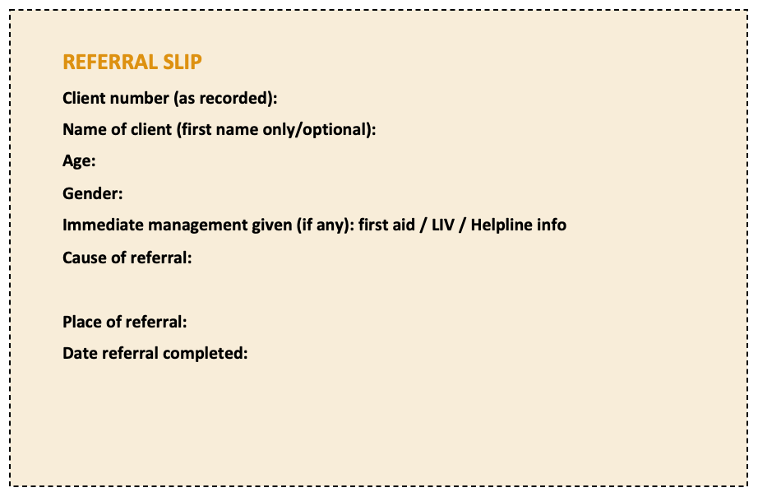
Forms and Formats of GBV Recording and Reporting
Source: Pathfinder International
INTEGRATING GBV-RESPONSE INTO FP AND RH SERVICE DELIVERY
MODULE 3 | SESSION C | SLIDE 29

Slide 30
Case Study 9: Lovely
Lovely Begum (pseudonym) is only 16 years old. Her parents had arranged to have her married to a nearby acquaintance when she turns 18, but a jealous cousin abducted her and forced her into wedlock. She tried to escape to her parents’ home after that the cousin made her isolated from everyone in the family, but her parents explained that because the marriage had been consummated, her previous betrothed will not take her anymore and told her she needed to go back to her husband.
Lovely returns to her husband’s house. Her husband continues to keep her at home and does not allow her to visit her parents anymore. He is angry that she tried to stay at her parents. He yells at Lovely and beats her frequently. He accuses Lovely of not getting pregnant on purpose.
Finally, after six months of life as a wife, Lovely discovers she is pregnant and goes to the SRH service center to get help for continuing her pregnancy. She is very worried about protecting her precious child in her womb and concerned that the beatings she is receiving at home will harm her child
INTEGRATING GBV-RESPONSE INTO FP AND RH SERVICE DELIVERY
MODULE 3 | SESSION C | SLIDE 30

Slide 31
Module 4
Foundational Knowledge of GBV Case Recording, Documentation, and Record Keeping
INTEGRATING GBV-RESPONSE INTO FP AND RH SERVICE DELIVERY
MODULE 4 | SLIDE 31

Slide 32
MODULE 4 | SESSION A
Legality, Protecting Confidentiality, and Reporting GBV
What You Can Expect to Learn
Gain an understanding of the legality and reporting aspect of a GBV case identification, notification to primary management and referral
INTEGRATING GBV-RESPONSE INTO FP AND RH SERVICE DELIVERY
MODULE 4 | SESSION A | SLIDE 32

Slide 33
Defining “Legality”
Legality is an act, agreement, or contract that is consistent with the law or state of being lawful or unlawful in a given jurisdiction, and the construct of power. Legal assistance describes a range of legal services, from the provision of generic legal information and advice to representation by a legal professional in court.
INTEGRATING GBV-RESPONSE INTO FP AND RH SERVICE DELIVERY
MODULE 4 | SESSION A | SLIDE 33

Slide 34
Legal Considerations for FP and SRH Providers Around GBV
Health care providers do not have a legal mandate to report GBV. You should only report cases to judicial authorities if and with a client’s written consent.
Documentation of disclosure, injuries, or other medical records may become evidence in the event a survivor chooses to file a legal complaint and prosecution follows.
Universal provision of referral options and GBV services available is not legally required but is ethically mandated.
INTEGRATING GBV-RESPONSE INTO FP AND RH SERVICE DELIVERY
MODULE 4 | SESSION A | SLIDE 34

Slide 35
Integrating GBV Disclosure and Response Reporting into an FP and SRH Visit
What to Include in Your Report
Basic demographic information
Consents obtained
History
Account of the assault
Results of the physical examination
Tests and results
Treatment plan medication provided or prescribed
Referrals provided
Anonymous code for use in referral communication
Information shared by client
Provider observations
Use separate forms provided. GBV disclosures should NOT be noted in the regular FP register.
Immediately following the visit, place your documentation form in an assigned, locked storage space.
Document in three places: confidential client record, referral slip, and anonymized facility log.
INTEGRATING GBV-RESPONSE INTO FP AND RH SERVICE DELIVERY
MODULE 4 | SESSION A | SLIDE 35

Slide 36
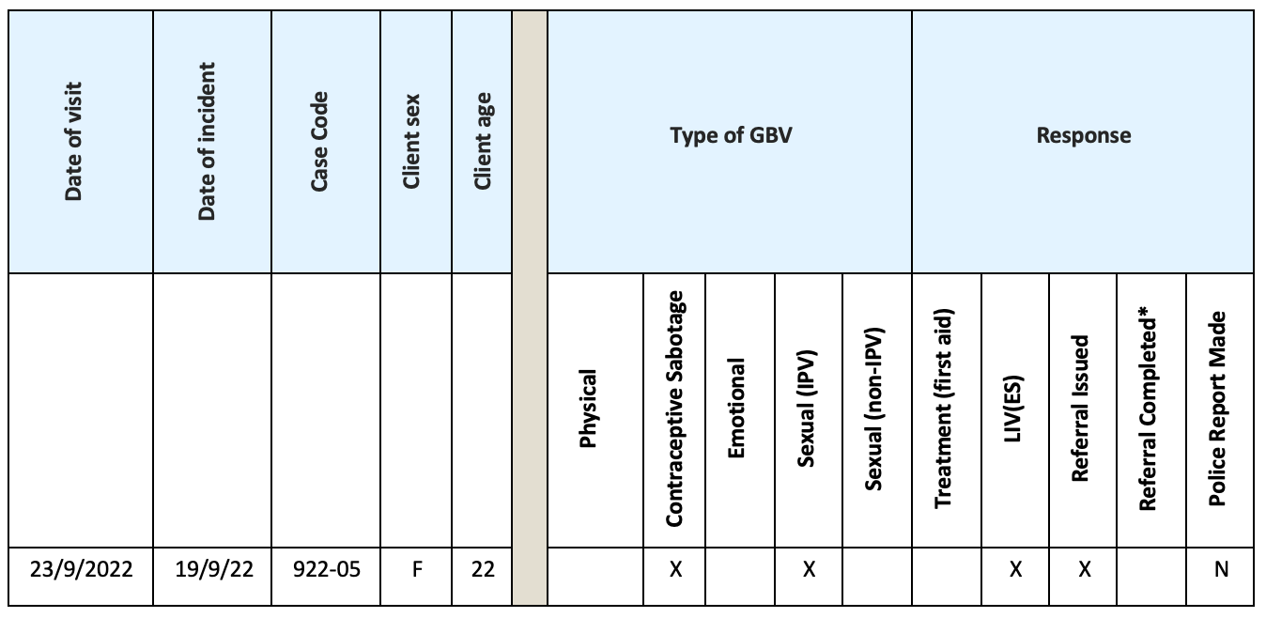
Facility Registers for Recording Cases of GBV
Source: Pathfinder International
INTEGRATING GBV-RESPONSE INTO FP AND RH SERVICE DELIVERY
MODULE 4 | SESSION A | SLIDE 36

Slide 37
Case Study 10: Aklima
Using the sample referral and GBV record forms, fill out the documentation needed based on the information from Aklima’s story.
For Reflection and Group Discussion
What was the hardest pieces of the form to complete?
Do you think you will be able to do this during a normal day of work?
Do you have any questions on how to fill out a certain portion of the forms?
INTEGRATING GBV-RESPONSE INTO FP AND RH SERVICE DELIVERY
MODULE 4 | SESSION A | SLIDE 37

Slide 38
Module 5
Closing
INTEGRATING GBV-RESPONSE INTO FP AND RH SERVICE DELIVERY
MODULE 5 | SLIDE 38

Slide 39
Key Messages
FP/SRH providers have a critical role to play in first line response for violence against women and girls.
Basic services such as GBV-responsive FP method counseling, psychological first aid, and appropriate activation of a referral chain can have significant impact on the trajectory of care for people living with GBV.
FP/SRH providers have a significant role to play in safe, confidential reporting, and documentation of GBV prevalence and incidence.
INTEGRATING GBV-RESPONSE INTO FP AND RH SERVICE DELIVERY
MODULE 5 | SESSION A | SLIDE 39

Slide 40
Wrap Up
You have three final steps in this training:
Complete your individual action plan
Take the post-test
Meet with a trainer for clinical competency assessment
INTEGRATING GBV-RESPONSE INTO FP AND RH SERVICE DELIVERY
MODULE 5 | SESSION A | SLIDE 40

Slide 41
Questions?
INTEGRATING GBV-RESPONSE INTO FP AND RH SERVICE DELIVERY
MODULE 5 | SESSION A | SLIDE 41

Slide 42
Thank you!

